Slide 1
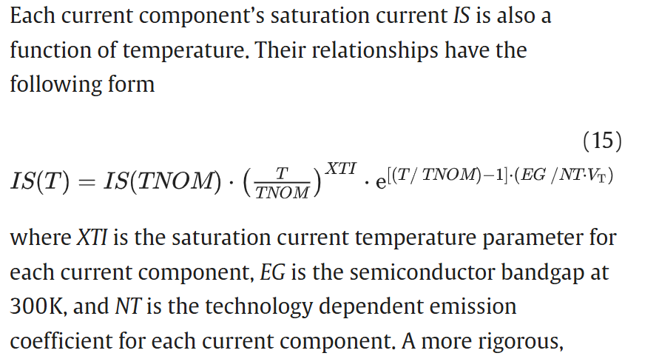
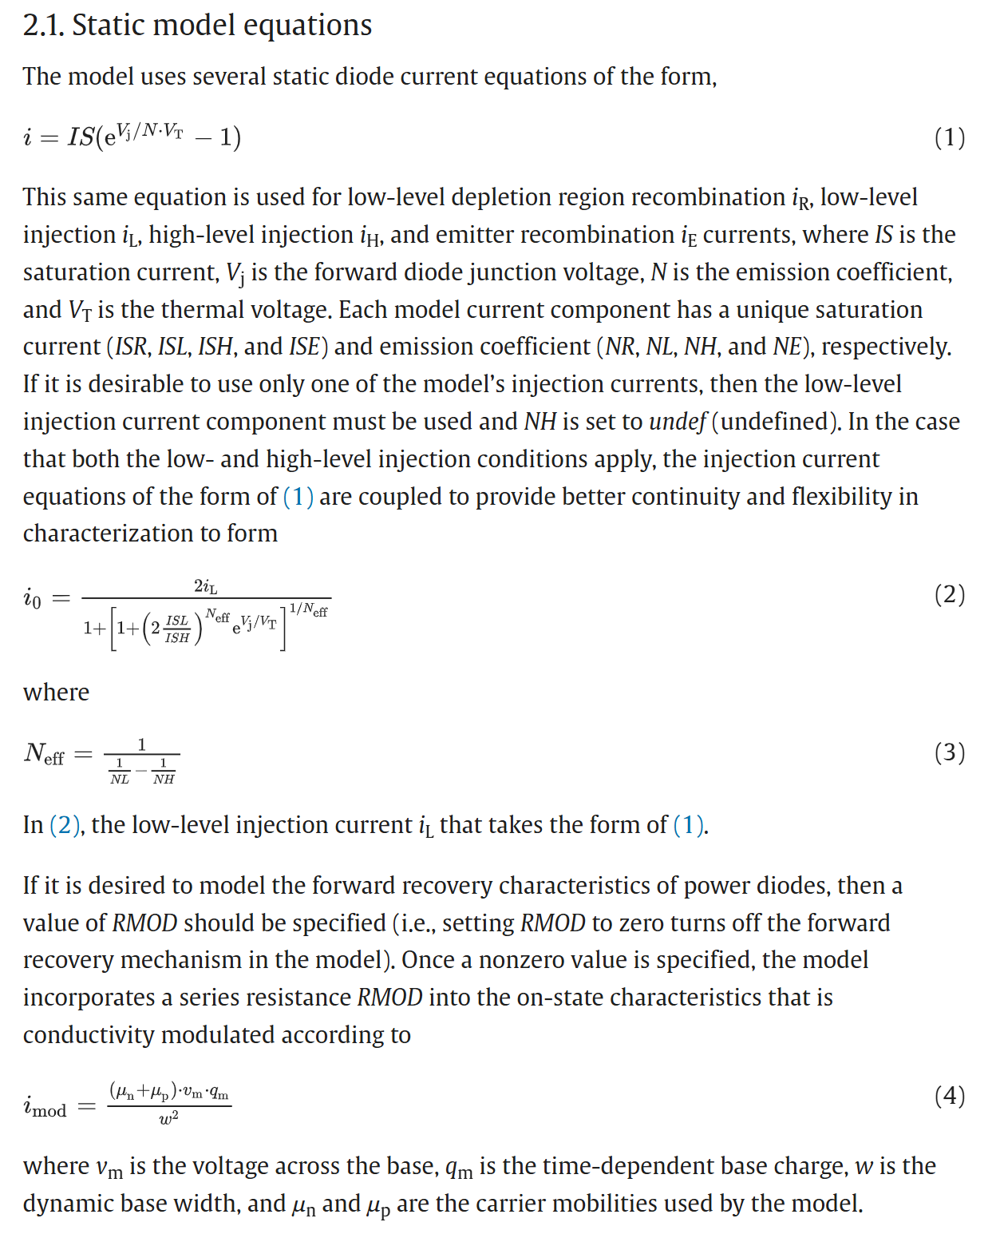









Ty R. McNutt, Allen R. Hefner, H. Alan Mantooth, Jeff L. Duliere, David W. Berning, Ranbir Singh,
Physics-based modeling and characterization for silicon carbide power diodes,
Solid-State Electronics,
Volume 50, Issue 3,
2006,
Pages 388-398,
ISSN 0038-1101,
https://doi.org/10.1016/j.sse.2006.01.013.
Has the form AT^r * e^(m/T-p)
Parameters that depend on temperature:
V_T, I_sl, I_sh, Nl, Nh, Eg, Resistance, mobility

